Slide 1
UCS677: Data Engineering
Course Instructor: Dr. Mandeep Kaur

Slide 2
Syllabus
Getting started with MongoDB
CRUD operations
Collections
Indexes
Sharding and Replication

Slide 3
Course Learning Outcomes (CLOs) / Course Objectives (COs):
Learn NoSQL, Mongo DB, and Javascript.
Apply basic concepts of indexing and collections using MongoDB.
Formulate the basic usage of database such as graph-based database, creating and dropping of collections, and indexing and solving real-world problems.
Able to handle and update multiple documents using Mongo DB.
Able to manage database for availability and performance, and scaling of database.

Slide 4
Marks Distribution:
EST : 40 marks
        MST : 30 marks
        Quiz : 15 marks
        Lab Project : 15 marks
L | T | P | Cr
2 | 0 | 2 | 3.0

Slide 5
Introduction
Databases are systems that store, modify, and access collections of information electronically.
Data Types: Databases can store a variety of data types including strings, numeric data, booleans, dates and times, and files of various extensions.
Database Management System (DBMS): A database management system (DBMS) is software designed to manage a database.
Database management systems allow developers to communicate with a database, via code or a graphical user interface, to perform database operations and administrative actions such as user management.

Slide 6
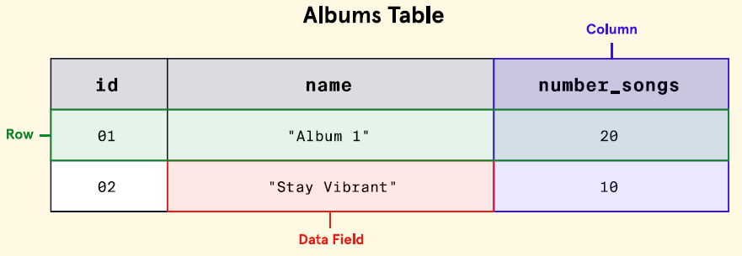
Tabular Form
Tabular form refers to a database structure that stores data as a collection of tables with each table consisting of several rows and columns.

Slide 7
Relational or SQL Databases
Relational databases organize data into individual tables via rows and columns.
Each column represents an attribute of the data stored and each row is an individual record of the data.
Many relational databases use Structured Query Language (SQL) to store and retrieve data, and as such are often referred to as SQL databases.

Slide 8
Relational Database Relationship Types:
“one-to-one”, “one-to-many”, and “many-to-many”
Database Schema:
A database schema is a blueprint that outlines how a database’s data will be structured and organized. It is always a good idea to have a database schema in place before actually inserting data.
Relational databases typically follow predefined schemas. Developers outline the tables and their associated relationships before inserting any data.

Slide 9
SQL Databases: Disadvantages
Two considerable disadvantages of working with relational databases are:
They can be costly to set up, scale, and maintain.
The organization of data into tables consumes a great deal of space which can negatively impact cost and performance.

Slide 10
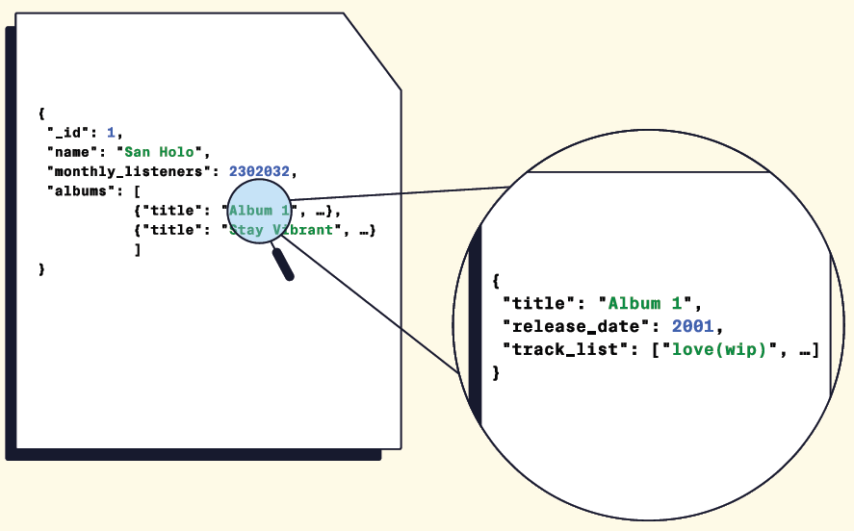
Non-Relational or NoSQL Databases
Non-relational, or NoSQL, databases is an umbrella term that refers to any database that does not follow the relational model provided by traditional database management systems.
Database that stores data in JSON format.

Slide 11









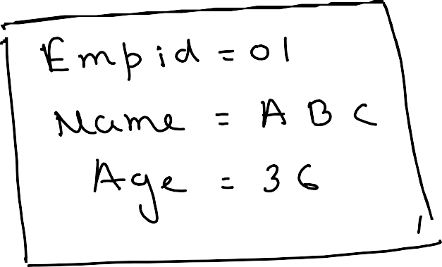
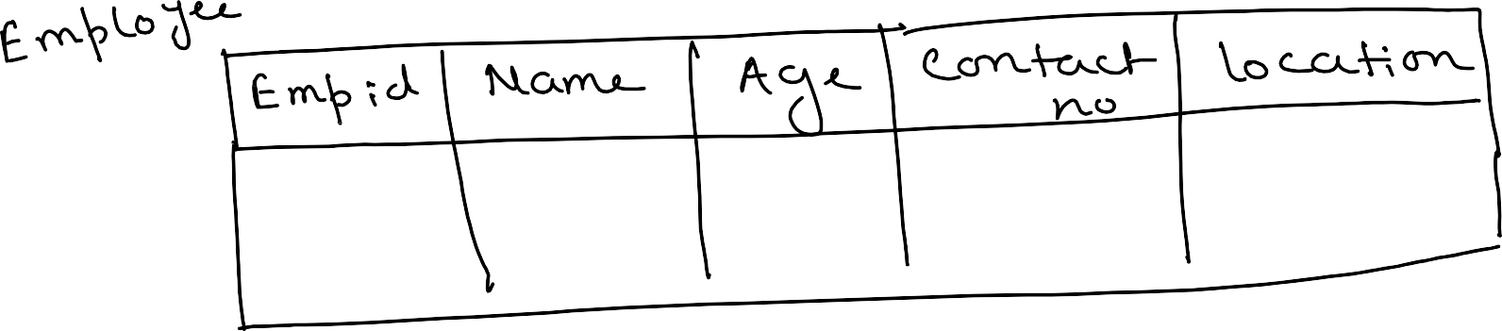
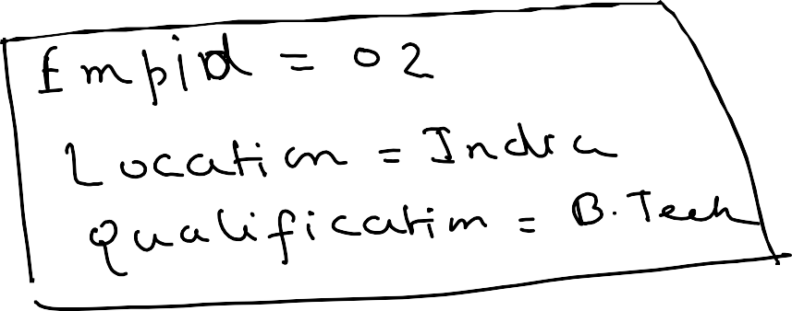









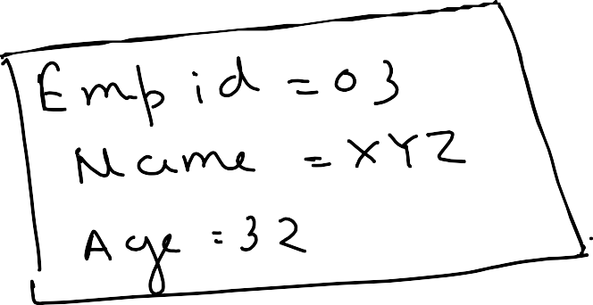










































Slide 12
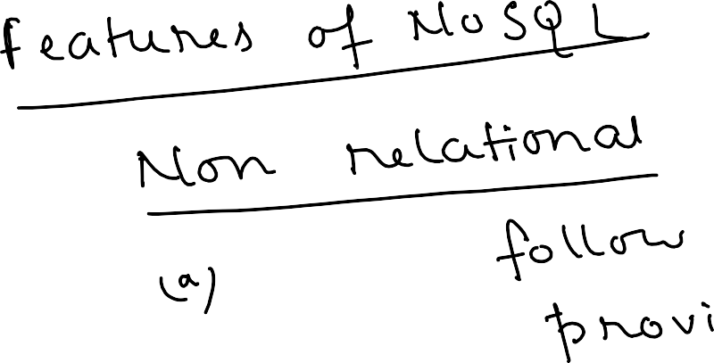












































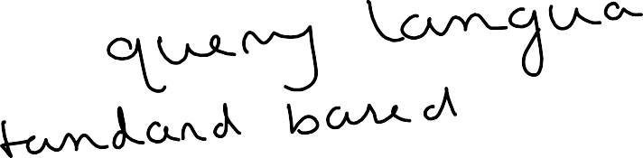








Slide 13
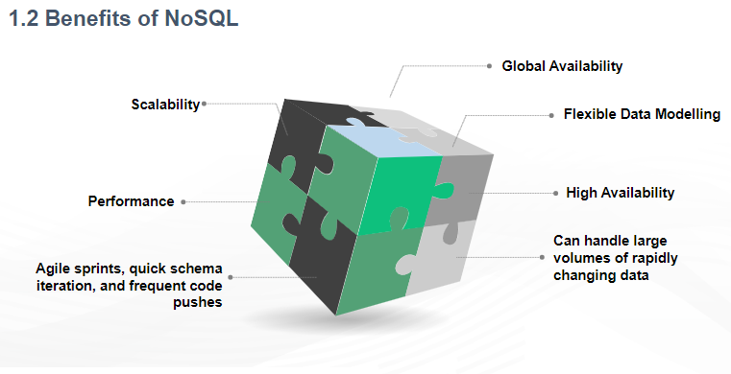

Slide 14
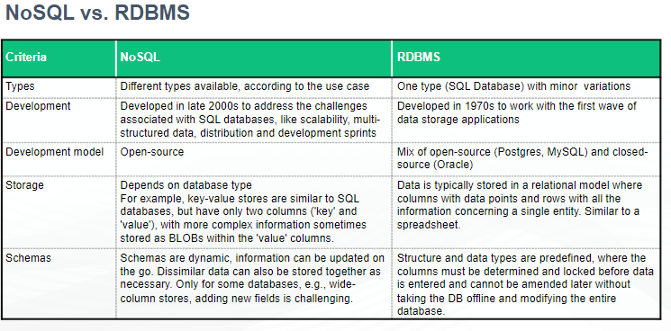

Slide 15
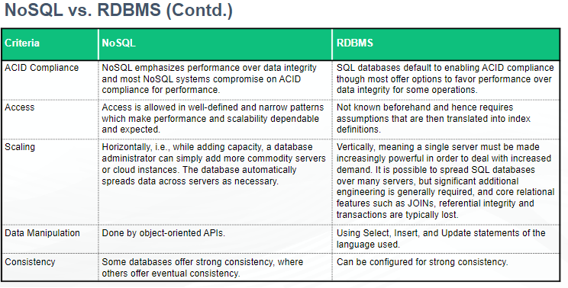

Slide 16
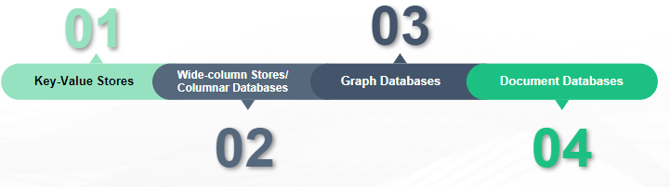
Types of Databases

Slide 17
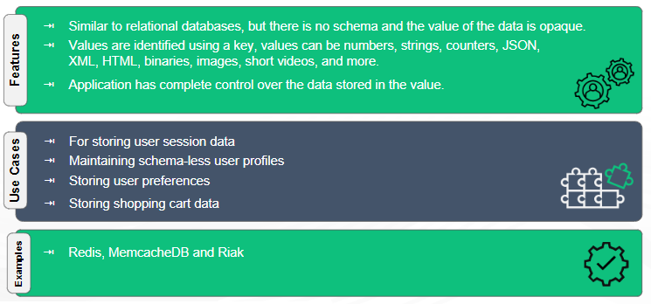
Key-Values Stores
A key-value NoSQL database uses individual records consisting of:
Name, which is the key
Data, which is the value
The data is assigned to a name when stored.

Slide 18
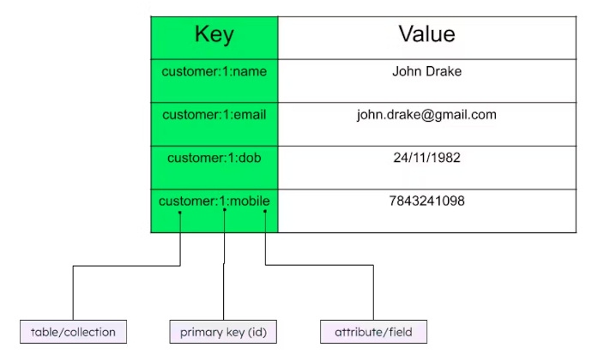
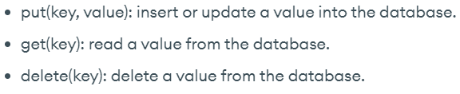

Slide 19
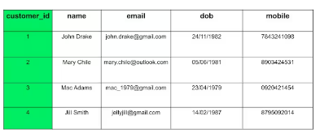
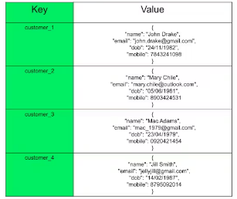

Slide 20
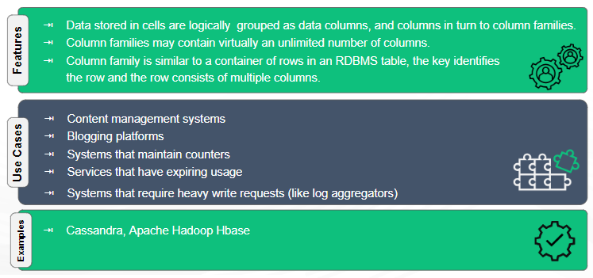
Wide-Column Stores/ Columnar Databases
A column-oriented NoSQL database groups data into columns instead of using the rows of a traditional database.
The columns can consist of different sizes and stored data types.

Slide 21
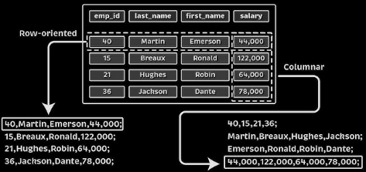

Slide 22
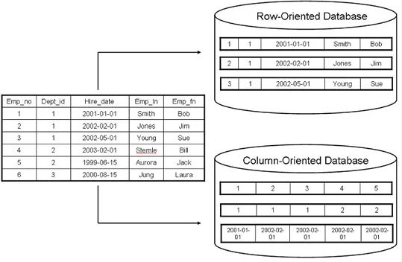

Slide 23
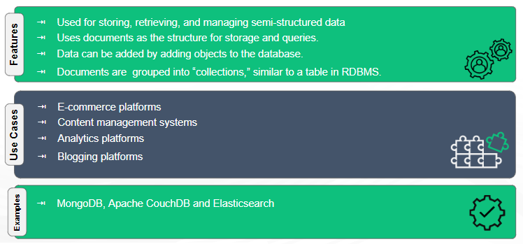
Document/Document-Store/Document-Oriented Databases
A document-based NoSQL database stores objects which contain data in standard encodings such as JSON or XML.

Slide 24
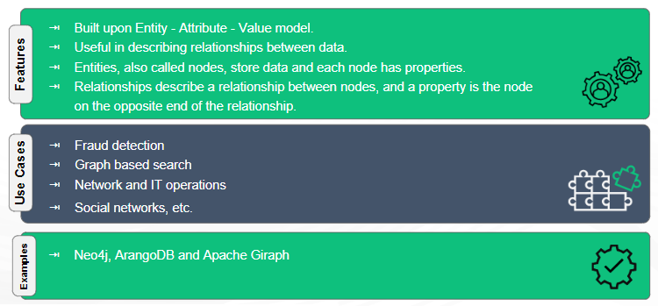
Graph-based Databases
A graph-based NoSQL database connects many data objects (nodes) together through relationships (edges).
This type of database combines the querying of relational databases with NoSQL flexibility and scalability.

Slide 25
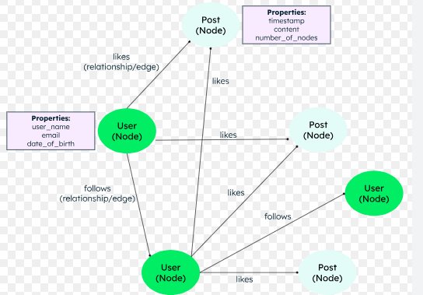

Slide 26
Introduction to MongoDB
MongoDB is a non-relational, document-oriented, open source, cross platform, and distributed database imparted with high performance and easy scalability database system.
It’s the scalability feature of this database which gives it the name Mongo taken from the word “humongous” which means large-sized.
It requires “Collection” (tables in MySQL) of “Documents” (Rows and columns in MySQL) to build the database.
Data is formatted as JSON or BSON and is stored inside documents.

Slide 27
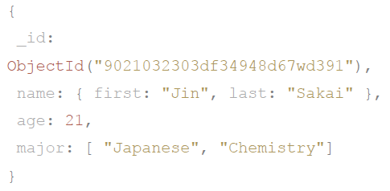
BSON and JSON
Binary Javascript Object Notation (BSON) is a non-human-readable data format that MongoDB uses to store data more efficiently than JSON. BSON takes up less space, is faster to parse, and can store more data types than JSON.
JavaScript Object Notation (JSON) is a human-readable, text-based data format that MongoDB uses for insertion and retrieval of data.
Data is inserted and retrieved in MongoDB documents as JSON.

Slide 28
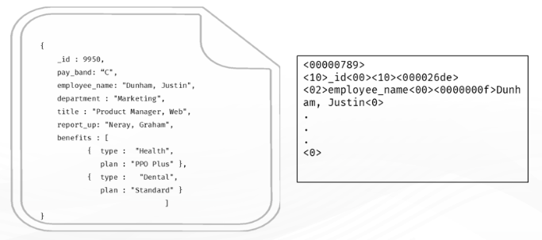
BSON is not JSON
JSON is text format that requires character by character parsing (like CSV) and provides fewer data types (integers, strings etc.)
BSON is a serialized binary objects with types, lengths (variable-length strings).
BSON is faster to read and traverse.
BSON is similar to how we used to save objects to disk before putting them in database.

Slide 29
JSON/BSON Relationship in MongoDB:
MongoDB allows developers to insert or retrieve data in readable JSON format. Internally, MongoDB stores data as BSON, a format that is not readable by humans, but is a more efficient way for MongoDB to store and parse data.
BSON Advantages Over JSON:
Storage efficiency and supporting data formats that JSON does not - like dates. BSON is also faster to parse than JSON.
JSON Advantages Over BSON: it is highly structured and parsable by humans.

Slide 30
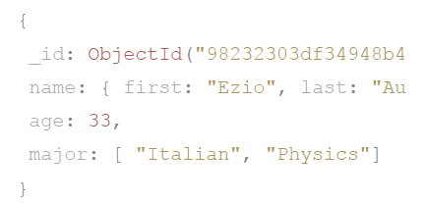
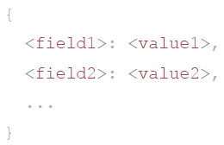
MongoDB Document: A MongoDB document is an individual record of data stored as “field-value” pairs.
A field uniquely identifies a data point while a value is the data point itself.
Documents containing related content are grouped into collections. The document model used by MongoDB is in contrast to the relational database model where data is stored in tables via rows and columns.

Slide 31
MongoDB - Document Modification Effects
Within a document-oriented database, like MongoDB, modifications made to a single document will only impact that document. This flexibility is an advantage over relational databases where changing a column of a table will impact every record in the table.

Slide 32
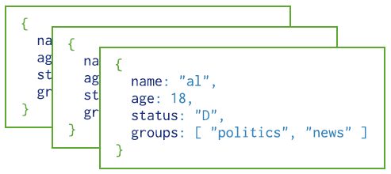
MongoDB Collection
A MongoDB collection is a group of documents containing similar information. Documents within a collection can have different fields, though they tend to share a similar structure.

Slide 33
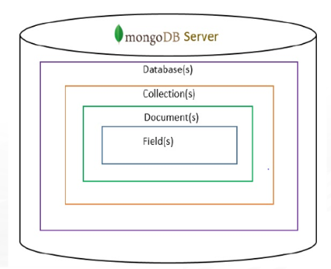
MongoDB Data Hierarchy
A MongoDB database is a number of collections grouped together for a specific use case. A database is made of many collections and collections are made of many documents.

Slide 34
MongoDB Atlas
MongoDB Atlas is MongoDB’s database-as-a-service or DBaaS platform. Using Atlas, MongoDB databases can be created, managed, and deployed from the cloud. Data analytics and data visualization are also available on this platform.

Slide 35
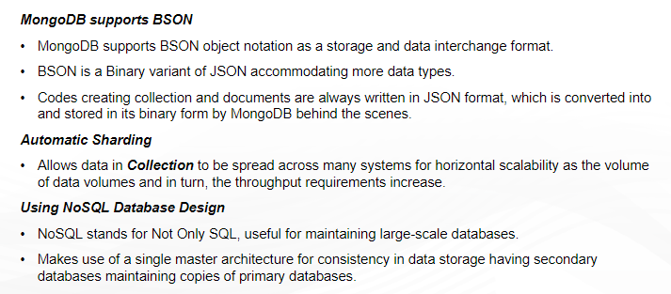
Features of MongoDB

Slide 36
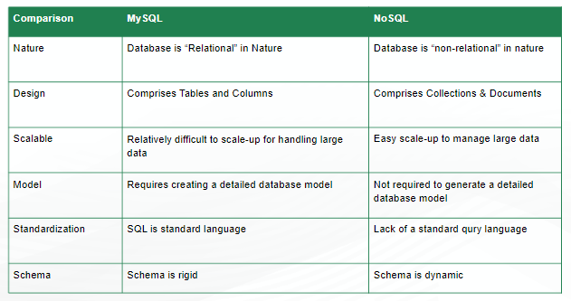
Comparison of MySQL and NoSQL

Slide 37
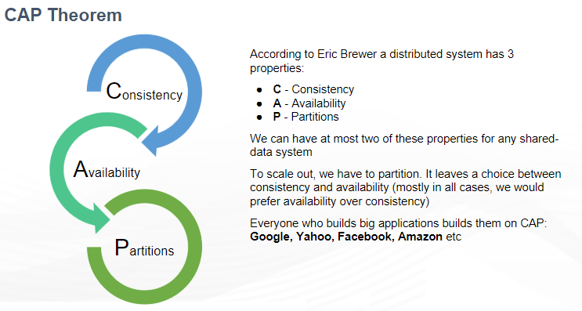
Consistency: All the nodes see the same data at the same time.
Availability: Every request receives a response.
Partition Tolerance: The system continues to operate even if the part of the system fails/message being dropped or delayed.
MongoDB as Per CAP Theorem:
MongoDB is strongly consistent by default .
MongoDB also gets high availability.

Slide 38
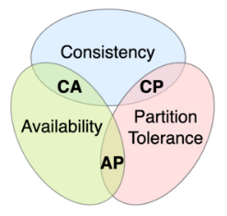
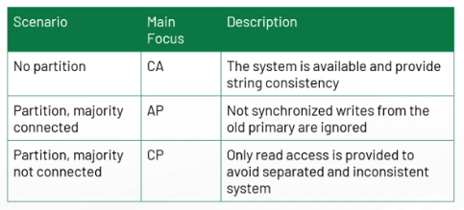

Slide 40
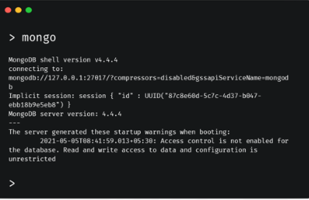
Mongo shell
The mongo shell is an interactive JavaScript interface to MongoDB.
It is used to query and update data as well as perform administrative operations.
Performs CRUD operations.

Slide 41
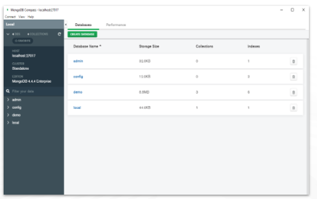
MongoDB Compass
MongoDB Compass is a powerful GUI for querying, aggregating, and analyzing MongoDB data in a visual environment.
Compass is free to use and source available, and can be run on macOS, Windows, and Linux.

Slide 42


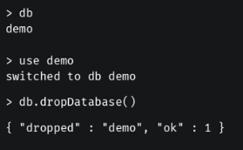
Commands
Create database
Display the list of database
Drop database
To drop database first make sure right database must be selected.

Slide 43
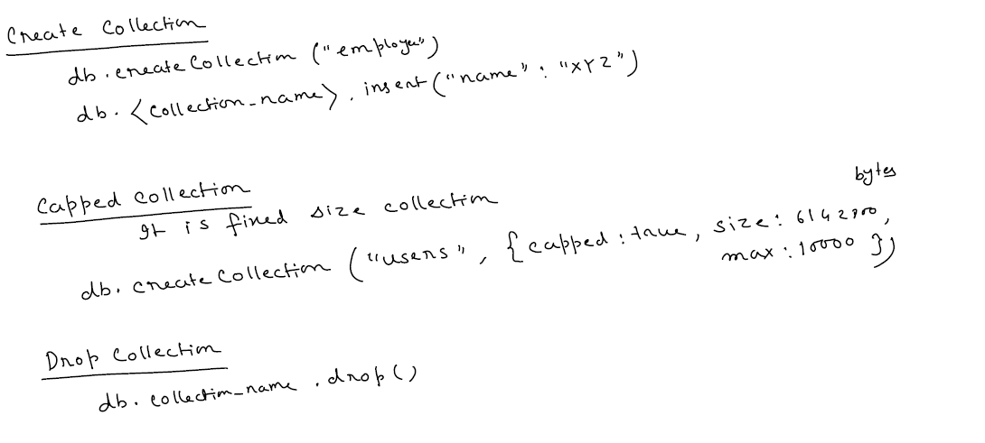

Slide 44
